Slide 1

Online Learning Impact analysis
Submitted in the partial fulfillment for the award of the degree of
BACHELOR OF ENGINEERING
IN COMPUTER SCIENCE WITH SPECIALIZATION IN BIG DATA ANALYTICS
Submitted by:
RAJ SINGH 22BDA70035 ANMOL RANA 22BDA70032 GAUTAM SINGLA 22BDA70030 SIDHARTH PUNDIR 22BDA70006
Under the Supervision of:
DR. AMARDEEP SINGH
Department of AIT-CSE
DISCOVER . LEARN . EMPOWER

Slide 2
INDEX
1. Introduction
2. Literature Review
3. Research Gaps
4. Proposed Metrics (LFI & RDP)
5. Methodology
6. Results & Discussion
7. Comparative Analysis
8. Conclusion & Future Work
9. References

Slide 3
ABSTRACT
Online learning analytics lack behavioral depth, focusing mainly on completion rates and viewing time
This study introduces two novel metrics:
Learning Fragmentation Index (LFI)
Replay Dependency Phenomenon (RDP)
Empirical study conducted on 80 university students (2025–2026) using structured survey data
Key Finding:
28.3% learners exhibit high fragmentation (LFI ≥ 0.65)
31.7% show high replay dependency (RDP ≥ 0.60)
Both metrics show strong negative correlation with learning effectiveness

Slide 4
1. INTRODUCTION
Online learning has expanded rapidly, with millions of students using video-based MOOCs and LMS platforms. While flexibility is gained, challenges in engagement, attention, and learning quality remain significant.
Limitations of Existing Metrics:
Completion rate ≠ actual learning
Viewing time ≠ attention or understanding
Lack of insight into behavioral patterns
Problem: Two under-studied phenomena affect learning quality:
Learning Fragmentation - interrupted, discontinuous sessions impair deep processing and knowledge integration
Replay Dependency - over-reliance on pause/replay may indicate cognitive overload or passive learning
Objective:
Define, compute, and validate LFI and RDP; identify at-risk learners; provide actionable thresholds for educators and platform developers.

Slide 5
2. LITERATURE REVIEW
Study | Focus Area | Key Findings
Er et al. (2024) | Learning Analytics | Dashboards improve engagement
Kim et al. (2023) | Attention (EEG) | Detects low attention states
Zhang et al. (2024) | Replay Behavior | Excess replay → poor learning
Bühler et al. (2024) | Video Engagement | Behaviour linked to outcomes
Insight:
Existing metrics lack behavioral depth
No behavioral metric combining fragmentation + replay exists

Slide 6
3. RESEARCH GAPS
No systematic measure exists for learning fragmentation - session interruptions and discontinuity remain unquantified in online learning research
Replay behavior studied qualitatively, but no composite metric captures dependency vs. strategic use of replay
Most analytics rely on system logs, limiting applicability to platforms without full logging infrastructure
Demographic variables (gender, year of study) affecting fragmentation and replay patterns are under-explored
No threshold-based classification framework exists for identifying at-risk online learners using behavioral metrics

Slide 7
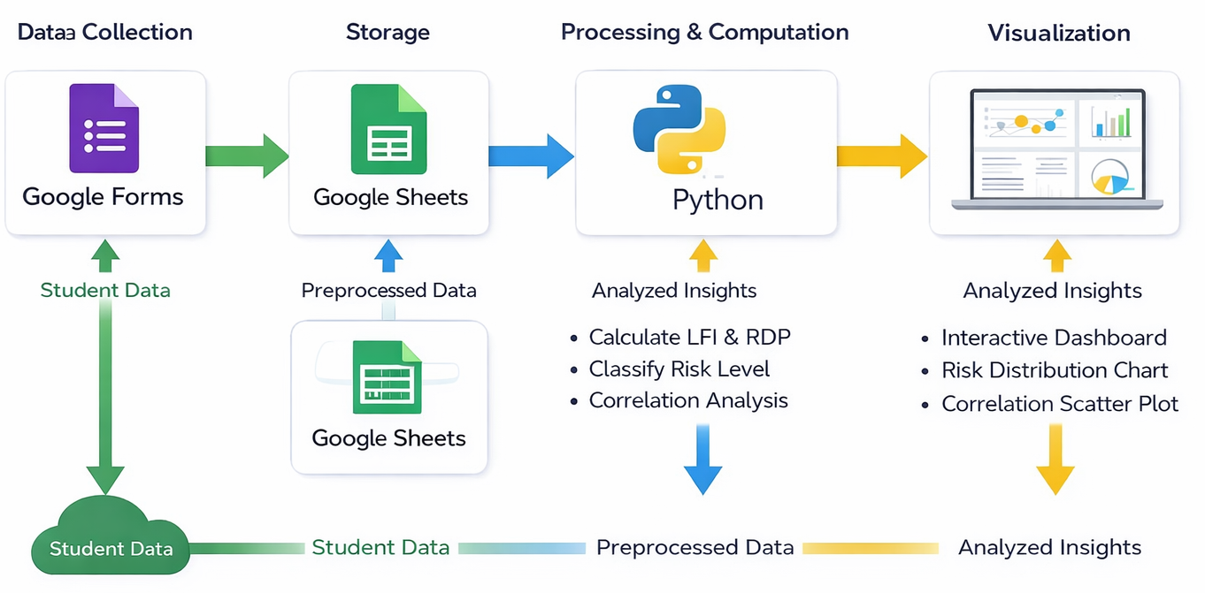
4. PROPOSED METHODOLOGY
5. Methodology Workflow
Survey Design:
80 students
5 sections
20 questions
Likert scale + numerical responses
Metric Computation:
LFI from 6 survey items (interruptions, session variability, focus difficulty)
RDP from 5 items (pause/replay frequency, content replayed %)
Statistical Analysis:
Descriptive stats
Pearson correlation
75th percentile threshold for high-risk classification
Reliability:
LFI α = 0.82
RDP α = 0.79

Slide 8
6. PROPOSED METRICS
Learning Fragmentation Index (LFI):
Measures interruptions and discontinuity
Based on:
Session breaks
Task switching
Focus difficulty
Replay Dependency (RDP):
Measures overuse of pause/replay
Indicates:
Cognitive overload
Passive learning

Slide 9
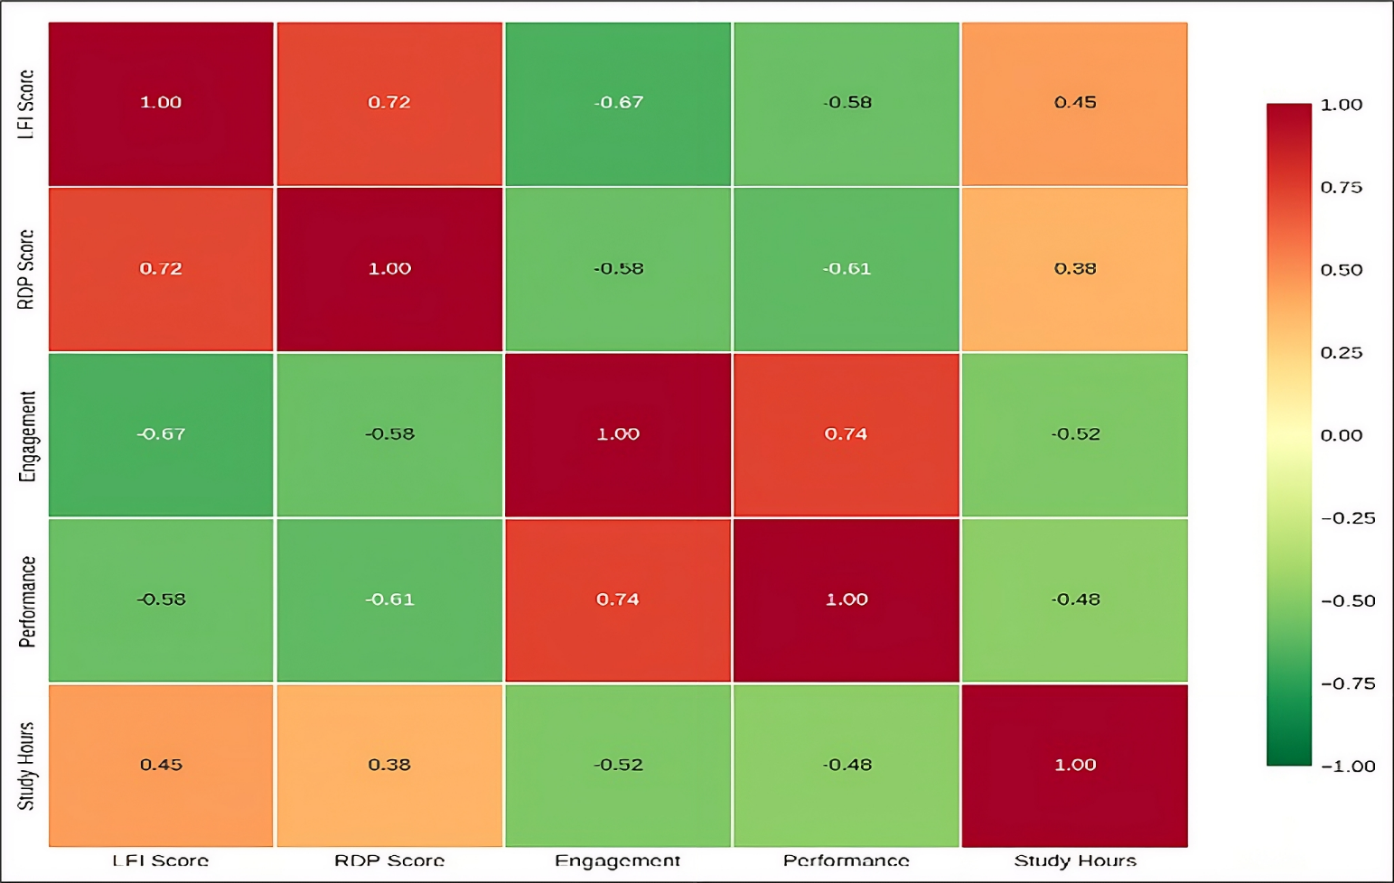
7. RESULTS & DISCUSSION
Descriptive Statistics (N=80)
Pearson Correlation Analysis
Metric | Mean | SD | High Risk
LFI | 0.59 | 0.19 | 28.3%
RDP | 0.48 | 0.21 | 31.7%
LFI ↔ Learning Effectiveness: r = -0.67 (p < 0.01) - strong negative
RDP ↔ Learning Effectiveness: r = -0.58 (p < 0.01) - moderately negative
LFI ↔ RDP: r = 0.54 - fragmented learners are also more likely to be replay-dependent
Temporal Stability: No significant linear trend over 4 weeks (LFI: p=0.68; RDP: p=0.74), suggesting stable individual traits
Mean LFI = 0.59 (SD = 0.19) - moderate fragmentation; 28.3% high-risk (LFI ≥ 0.65)
Mean RDP = 0.48 (SD = 0.21) - moderate dependency; 31.7% high-risk (RDP ≥ 0.60)
Both show moderate but significant variability

Slide 10
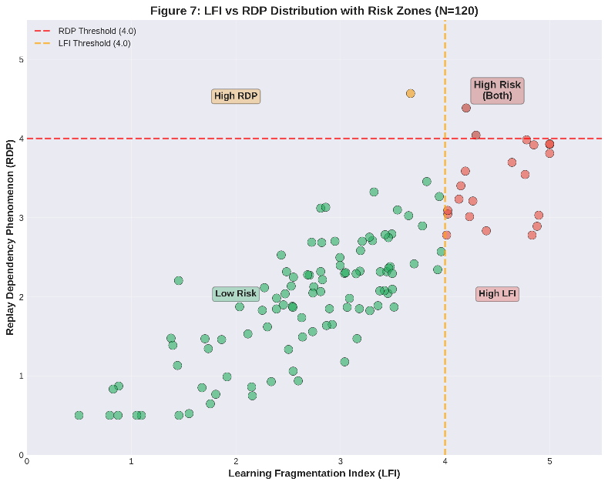
8. COMPARATIVE ANALYSIS
Risk Group Classification (N=120)
Key Observations:
Learning effectiveness decreases significantly with higher risk levels
High-risk learners show lower satisfaction and performance
Clear behavioral separation between low, moderate, and high-risk groups
Indicates strong relationship between LFI, RDP and learning outcomes
Risk Level | % | Learning Effectiveness | Satisfaction
Low | 56.7% | 7.6 | 7.9
Moderate | 25% | 6.4 | 6.7
High | 18.3% | 5.2 | 5.4

Slide 11
9. CONCLUSION & FUTURE WORK
Key Conclusions:
LFI and RDP are validated, reliable behavioral metrics for online learning assessment
High fragmentation and replay dependency negatively correlate with learning effectiveness (r = -0.67, -0.58)
Combined LFI-RDP model identifies at-risk learners with 82.5% accuracy - a practical early-warning tool
Future Work:
Validate LFI/RDP against objective system logs from LMS platforms
Longitudinal studies to test whether LFI/RDP are stable traits or context-dependent
Intervention studies: test if targeted support improves LFI, RDP and academic outcomes
Extend metrics to reading-based and simulation-based learning environments

Slide 12
10. REFERENCES
[1] E. Er, G. Özden, and M. Y. Özden, “Identifying behavioral patterns in MOOC video engagement using clustering approach,” Egitim Teknolojisi Kuram ve Uygulama, vol. 14, no. 2, pp. 45–62, 2024.
[2] Y. Sheng, L. Wang, and X. Chen, “Multimodal non-semantic feature fusion for predicting segment access frequency in lecture archives,” arXiv:2504.14927, 2025.
[3] G. Akçapinar, A. Altun, and P. Aşkar, “Decoding video logs: Unveiling student engagement patterns in lecture capture videos,” Int. Rev. Res. Open Distrib. Learn., vol. 25, no. 2, pp. 123–145, 2024.
[4] L. Bühler, M. Bétrancourt, and P. Dillenbourg, “On task and in sync: gaze synchrony and self-reported attention during video lecture learning,” Proc. ACM HCI, vol. 8, CSCW1, 2024.
[5] S. Kim, J. Park, and H. Lee, “Characteristic behaviors of elementary students in low attention states during online learning identified using EEG,” IEEE Trans. Learn. Technol., vol. 16, no. 5, pp. 678–692, 2023.
[6] J. Marty-Dugas, C. Ralph, and D. Smilek, “Active vs passive media multitasking and memory for lecture materials,” Heliyon, vol. 10, no. 11, p. e31935, 2024.
[7] Y. Zhang, L. Liu, and X. Wang, “Question generation type and organizational cues in video learning,” Active Learning Higher Educ., 2024. | [8] C. Kavitha et al., “Learning behaviour analysis using EEG and facial expression data,” Measurement: Sensors, vol. 27, 2023.
[9] J. Liang et al., “Teaching expectancy improves video-based learning,” Brit. J. Educ. Technol., vol. 55, no. 4, 2024. | [10] C. Vale et al., “Using learning analytics to understand K–12 learner behavior in online video-based learning,” Online Learning, vol. 28, no. 1, 2024.

